Slide 1
Database Language
A DBMS has appropriate languages and interfaces to express database queries and updates.
Database languages can be used to read, store and update the data in the database.
SQL
Structured Query Language (SQL) as we all know is the database language by the use of which we can perform certain operations on the existing database and also we can use this language to create a database.
SQL uses certain commands like Create, Drop, and Insert etc. to carry out the required tasks.

Slide 2
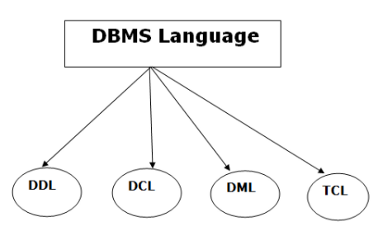
SQL
These SQL commands are mainly categorized into four categories as:
DDL – Data Definition Language
DML – Data Manipulation Language
DCL – Data Control Language
TCL -Transaction Control Language

Slide 3
DDL(Data Definition Language)
DDL or Data Definition Language actually consists of the SQL commands that can be used to define the database structure/ pattern.
It is used to create schema, tables, indexes, constraints, etc. in the database.
Using the DDL statements, you can create the skeleton of the database.
Data definition language is used to store the information of metadata like the number of tables and schemas, their names, indexes, columns in each table, constraints, etc.
Here are some tasks that come under DDL:
Create: It is used to create objects in the database.
Alter: It is used to alter the structure of the database.
Drop: It is used to delete objects from the database.
Truncate: It is used to remove all records from a table.
Rename: It is used to rename an object.
Comment: It is used to comment on the data dictionary.
These commands are used to update the database schema that's why they come under Data definition language.

Slide 4
DML(Data Manipulation Language)
DML(Data Manipulation Language): The SQL commands that deals with the manipulation of data present in the database belong to DML or Data Manipulation Language and this includes most of the SQL statements.
DML stands for Data Manipulation Language. It is used for accessing and manipulating data in a database. It handles user requests.
Here are some tasks that come under DML:
Examples of DML:
Select: It is used to retrieve data from a database.
Insert: It is used to insert data into a table.
Update: It is used to update existing data within a table.
Delete: It is used to delete all records from a table.
Merge: It performs INSERT operation, i.e., insert or update operations.
Call: It is used to call a structured query language or a Java subprogram.
Explain Plan: It has the parameter of explaining data.
Lock Table: It controls concurrency.

Slide 5
DML(Data Manipulation Language)
  CALL - statement calls a procedure created by the create procedure or declare procedure statement.
  EXPLAIN PLAN - command displays the execution plan chosen by the Oracle optimizer for SELECT, UPDATE, INSERT, and DELETE statements.
  LOCK TABLE - command is used to lock the table named sql_name in either EXCLUSIVE or SHARE mode. In EXCLUSIVE mode, the data of the table cannot be read or modified by another transaction. In SHARE mode, the data of the table can be read by concurrent transactions but modifications are still prohibited.

Slide 6
DCL(Data Control Language)
DCL (Data Control Language): DCL includes commands such as GRANT and REVOKE which mainly deals with the rights, permissions and other controls of the database system.
It is used to retrieve the stored or saved data.
The DCL execution is transactional. It also has rollback parameters. (But in Oracle database, the execution of data control language does not have the feature of rolling back.)
Here are some tasks that come under DCL:
Grant: It is used to give user access privileges to a database.
Revoke: It is used to take back permissions from the user.
There are the following operations which have the authorization of Revoke:
CONNECT, INSERT, USAGE, EXECUTE, DELETE, UPDATE and SELECT.

Slide 7
TCL(Transaction Control Language)
TCL (transaction Control Language): TCL commands deals with the transaction within the database.
TCL is used to run the changes made by the DML statement.
TCL can be grouped into a logical transaction.
Here are some tasks that come under TCL:
  COMMIT– commits a Transaction.
  ROLLBACK– rollbacks a transaction in case of any error occurs.
  SAVEPOINT–sets a save point within a transaction.
  SET TRANSACTION–specify characteristics for the transaction.

Slide 8
OVERALL DBMS STRUCTURE
In this topic, we will cover the Structure of Database Management System (DBMS). DBMS is responsible to store huge amounts of data and is capable of handling multiple requests from users simultaneously, it should be arranged properly.
A database is partitioned in modules that deal with each of the responsibilities of the overall system.
Components of DBMS are broadly classified as follows:
1. Query Processor :
(a) DML Compiler
(b) Embedded DML pre-compiler
(c) DDL Interpreter
(d) Query Evaluation Engine

Slide 9
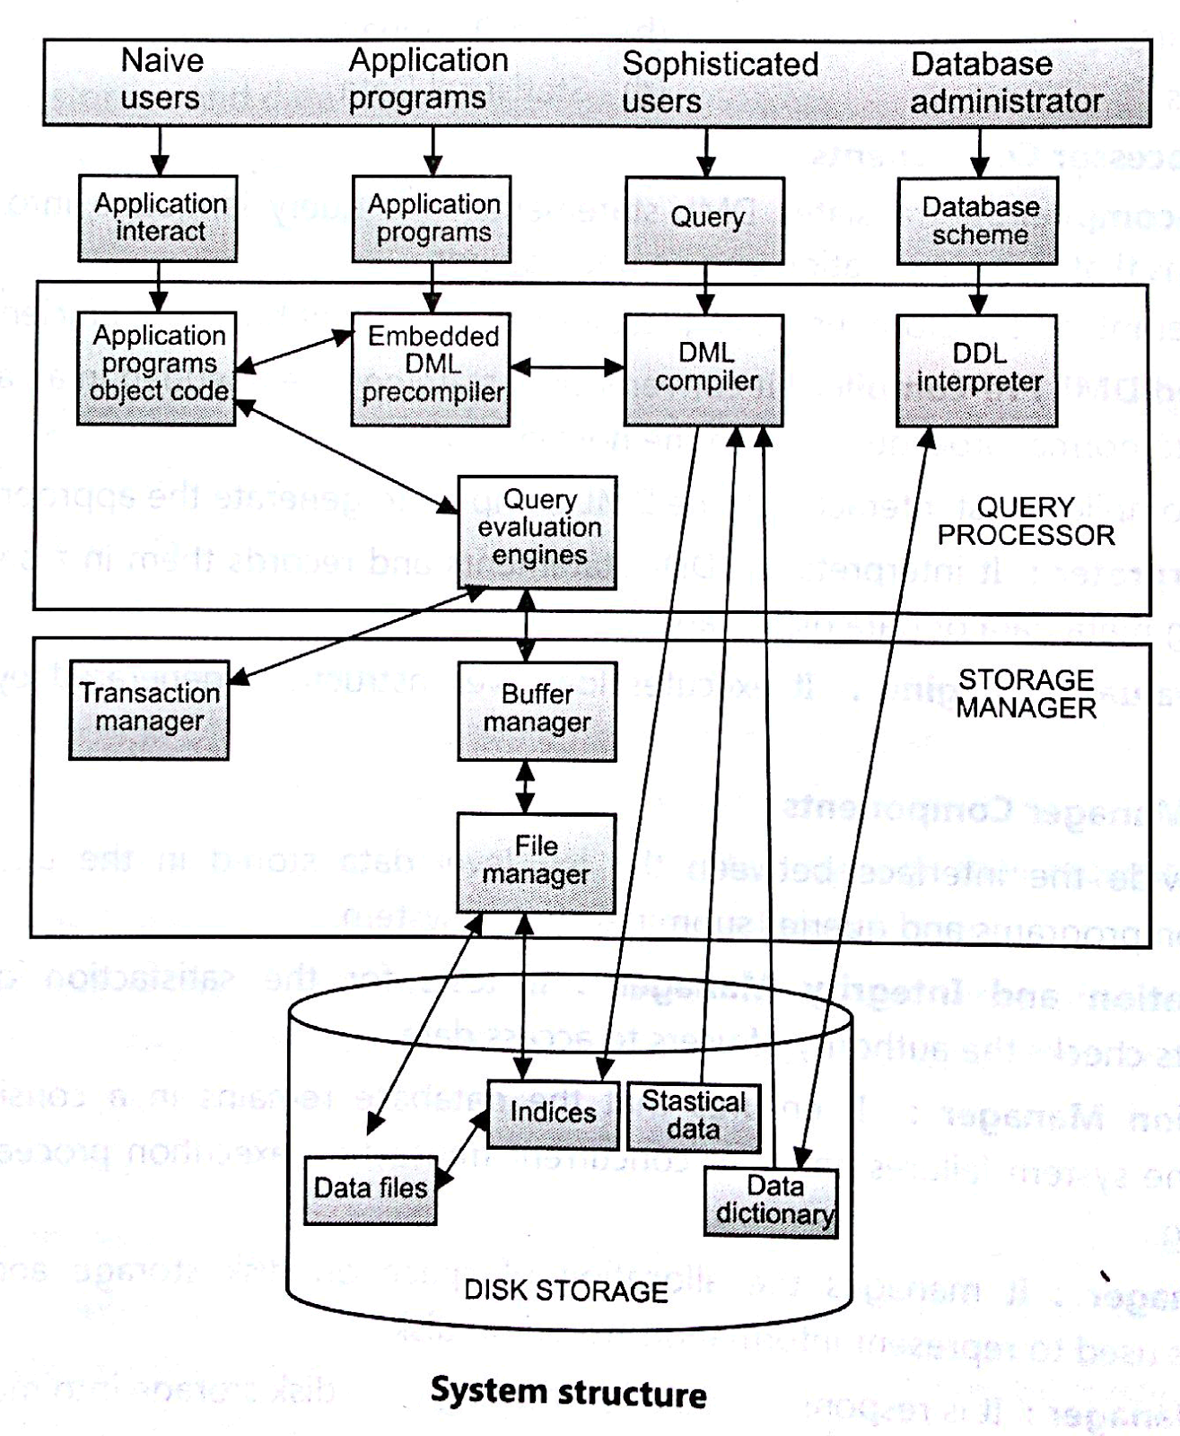
OVERALL DBMS STRUCTURE

Slide 10
OVERALL DBMS STRUCTURE
2. Storage Manager :
(a) Authorization and Integrity Manager
(b) Transaction Manager
(c) File Manager
(d) Buffer Manager
3. Data Structure :
(a) Data Files
(b) Data Dictionary
(c) Indices
(d) Statistical Data

Slide 11
Query Processor Components
DML Pre-compiler: It translates DML statements in a query language into low level instructions that query evaluation engine understands.
Embedded DML Pre-compiler: It converts DML statements embedded in an application program to normal procedure calls in the host language. The Pre-compiler must interact with the DML compiler to generate the appropriate code.
DDL Interpreter: It interprets the DDL statements and records them in a set of tables containing meta data or data dictionary.
Query Evaluation Engine: It executes low-level instructions generated by the DML compiler.

Slide 12
Storage Manager Components
They provide the interface between the low-level data stored in the database and application programs and queries submitted to the system.
• Authorization and Integrity Manager: It tests for the satisfaction of integrity constraints checks the authority of users to access data.
• Transaction Manager : It ensures that the database remains in a consistent state despite the system failures and that concurrent transaction execution proceeds without conflicting.
• File Manager : It manages the allocation of space on disk storage and the data structures used to represent information stored on disk.
• Buffer Manager : It is responsible for fetching data from disk storage into main memory and deciding what data to cache in memory.

Slide 13
Data Structures
Following data structures are required as a part of the physical system implementation.
• Data Files: It stores the database.
• Data Dictionary: It stores meta data (data about data) about the structure of the database.
• Indices: Provide fast access to data items that hold particular values.
• Statistical Data: It stores statistical information about the data in the database. This information is used by query processor to select efficient ways to execute query.

Slide 14

Database Users and Administrators
Database

Slide 15

Database System Internals

